Slide 1


3 December, 2022
Sponsored and Supported by:

Slide 2

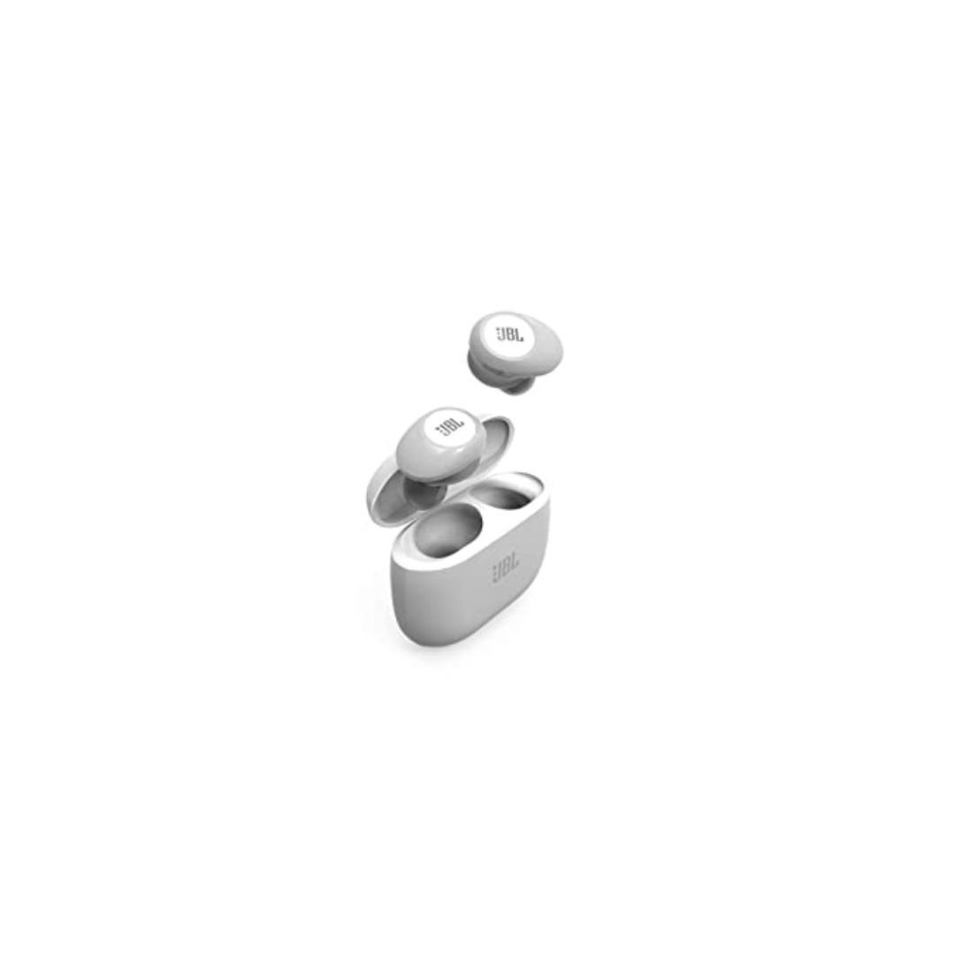
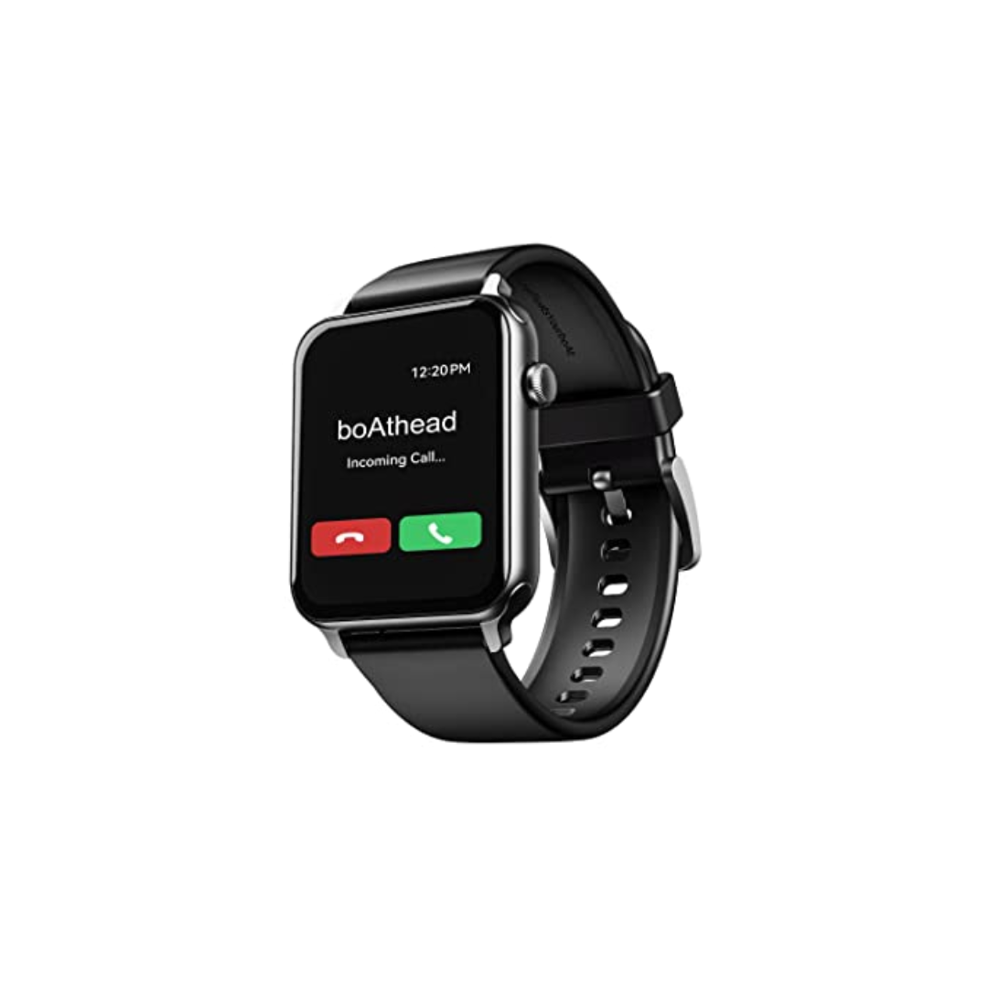
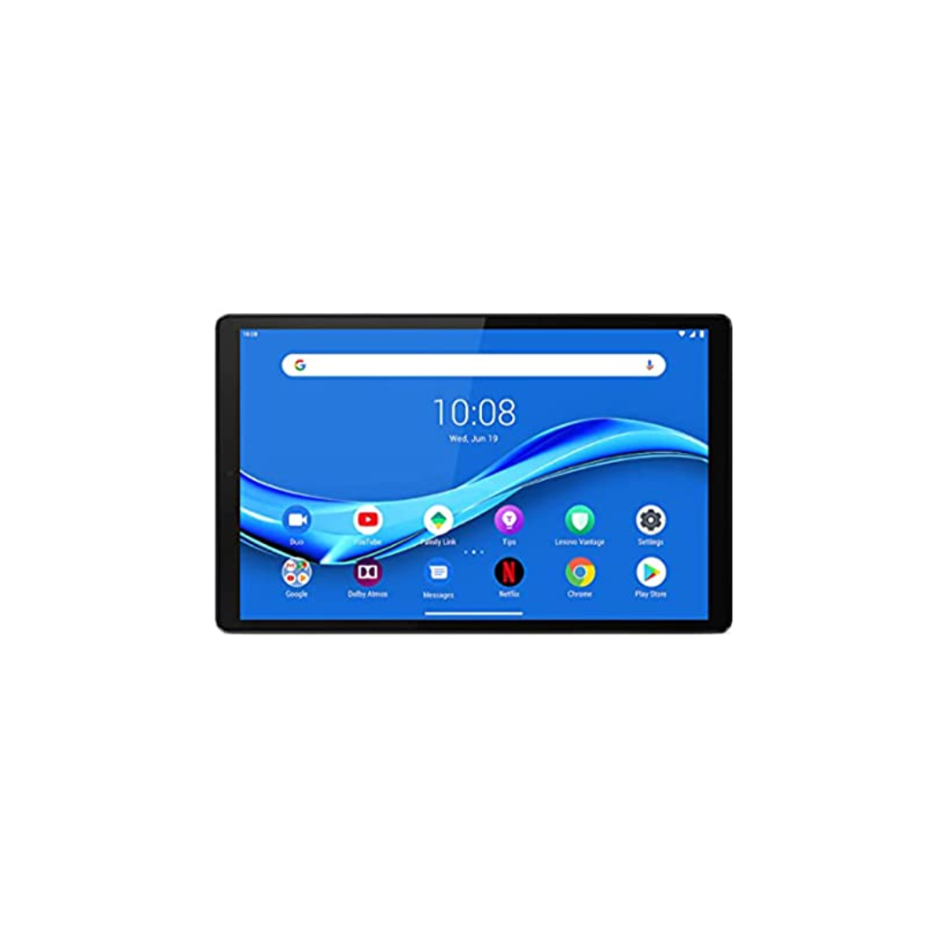
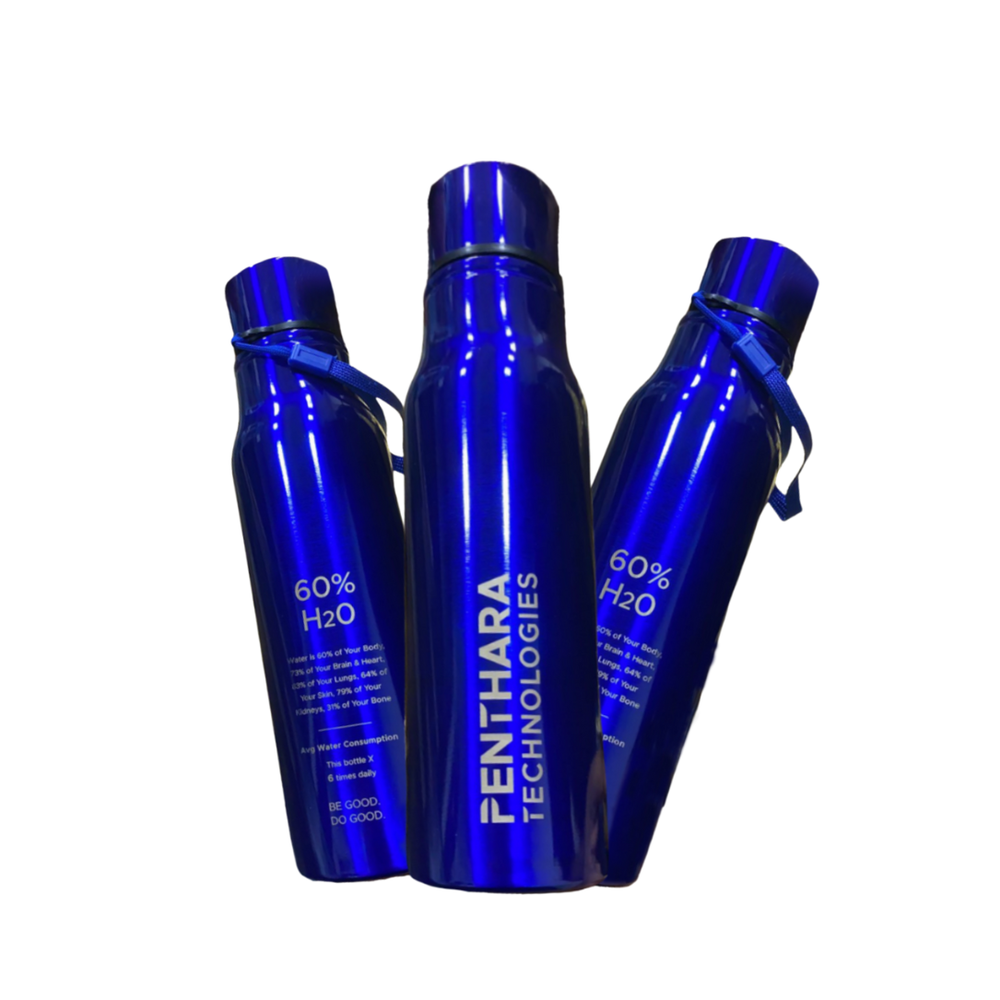

A One Day In Person Event
Win exiting prizes!
Lenovo M10 FHD Plus (2nd Gen)
JBL Tune 125TWS
boAt Blaze Smart Watch
Hands on sessions by experts and community leaders
Deep-dive into Microsoft 365 Services
Focus on:
Microsoft Teams
Power Platform
SharePoint
Cool Water Bottle
Developer Road Ahead

Slide 3

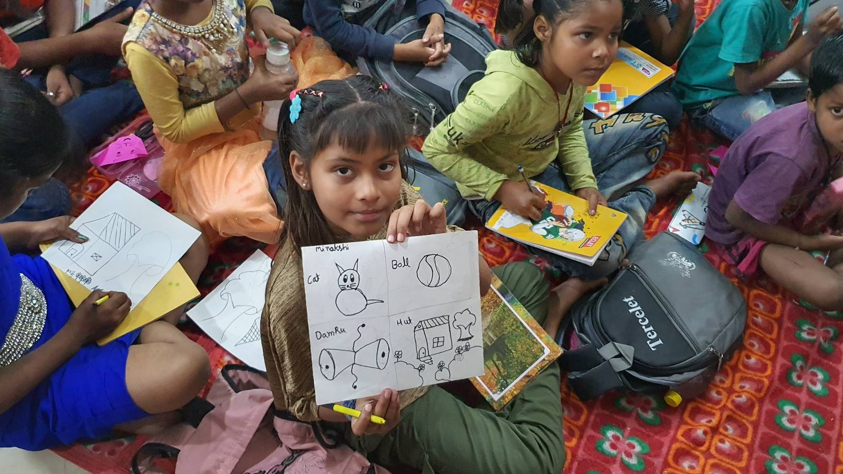
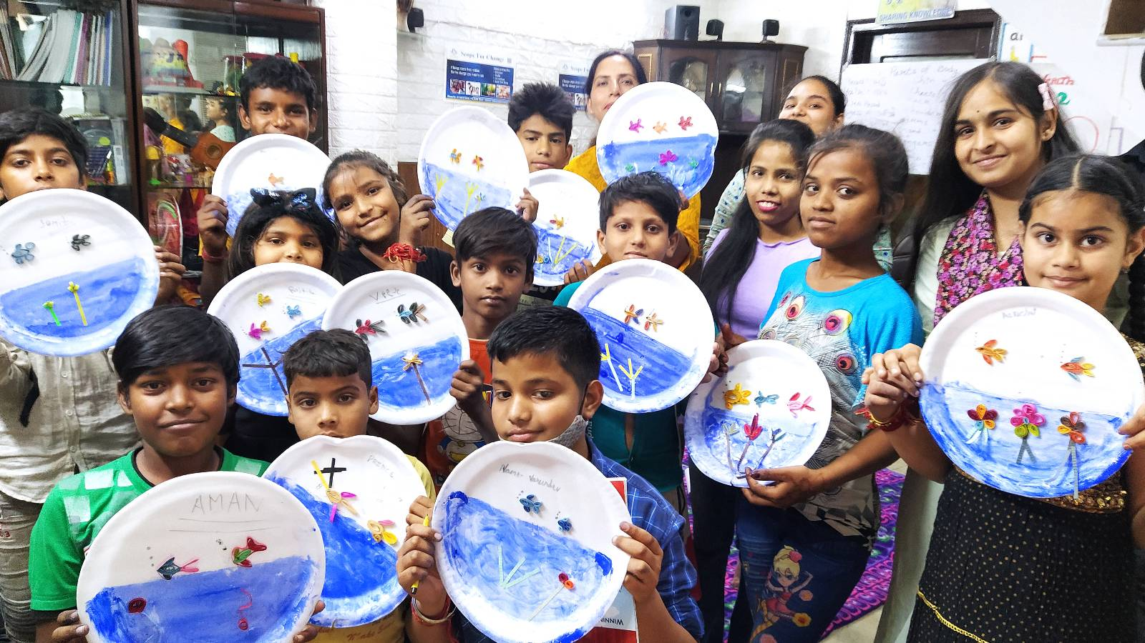

SUPPORT A CAUSE
“Giving is Receiving”
Support ‘Scope for Change’ to create more impact and touch the lives of more underprivileged students.

Slide 4

SPEAKERS PANEL
Session 4
How to configure DLP policies in Power Platform
11:00 AM – 11:45 AM
Aakash Maurya
Team Lead

Slide 5
Imagine Problem Statement
XYZ has its customer data such as Credit card information, personal identification information, business confidential data etc., stored in SharePoint lists/Dataverse/SQL Tables.
XYZ is very serious about its data privacy and data security.
XYZ realized that the company data is compromised.
After a long investigation XYZ identified that data was compromised via PowerApps & Power Automates.
One of the employee was sending data outside the organization by using Email connector.

Slide 6
Action needed
We need to provide solution to XYZ company to help them to protect their data from being shared outside the organization.

Slide 7
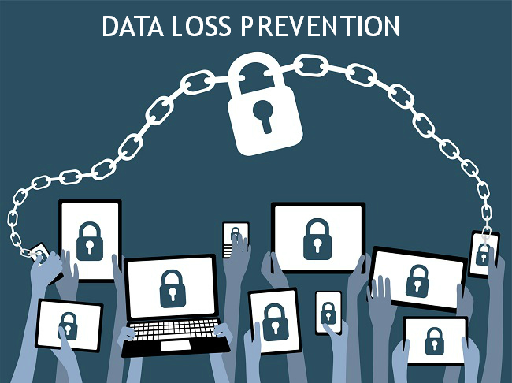
Solution

Slide 8
What is Data Loss Prevention (DLP) Policy
DLP policies are simple packages that are collections of mail flow rules (also known as transport rules) that contain specific conditions, actions, and exceptions that filter messages and attachments based on their content

Slide 9
Why DLP is used?
Protect confidential data from being lost intentionally or intentionally
Secure mobile workforce and enforce security in Bring Your Own Device (BYOD) environments
Secure data on remote cloud systems

Slide 10
From where we can create DLP?
Power Platform Admin Center

Slide 11
Permission hierarchy
DLP
Tenant Level
Tenant Admin
Environment Admin
Environment Level
Environment Admin
Single Environment
Multiple Environment
Owned Environment
Owned Environment

Slide 12
DEMO
Creating DLP Policy
Editing DLP Policy
Viewing DLP Policies
Deleting DLP Policies

Slide 13
Known Limitations
Blocking the HTTP connector will also block child flows because those child flows are called using the same HTTP connector technology.
If a child flow violates a DLP policy, it will not result in the parent flow becoming non-compliant.
There's no support for cross checking the categories between a cloud flow and the desktop flows it calls. This will be supported when DLP for desktop flows is generally available

Slide 14
Frequently Asked Questions
Can environment admins edit policies created by the tenant admin?
No
Can environment admins delete policies that were created by the tenant admin?
No
Can environment-level DLP policies can override tenant-wide DLP policies?
No
When I create new DLP policy, will it impact my existing Power Automates?
Yes, if your existing Power Automates is violating the DLP policy configured then your Power Automates will be automatically suspended by DLP background process

Slide 15

I am Listening
Your queries please

Slide 16







A Big Thank You to all the Sponsors!
Diamond:
Learning Partner:
Platinum:
Gold:

Slide 17

SPEAKERS PANEL
Next Session
Business automations using Power platform + Teams + Graph
11:50 AM – 12:35 PM
Sujithkumar P Sukumaran
CGI, Director Expert

